Slide 1

Developing Real Time and Secure Attendance Management System Using and BlockChain and ML
Group No. 14
Sindura Dasi- 19104015
Abdul Samad Ansari- 19104022
Ekta Gujar- 19104026
Guide: Prof. Yaminee Patil

Slide 2
Contents
Abstract
Introduction
Objectives
Literature Survey
Problem Definition
Technological Stack
Proposed System Architecture/Prototype
Suggestions given during review-1

Slide 3
1. Abstract
Most sectors employ facial recognition for authentication. Authentication is vital in the Information Age, and the need for faster and safer methods is growing. Face recognition has been boosted by image processing tools like OpenCV. Using blockchain, data may be saved in chunks over a network. It's a disruptive technology that might revolutionize society. This system uses OpenCV, LBPH (local binary pattern histogram) and Haar Cascades to construct a facial detection model for a blockchain-secured Attendance Monitoring System. It will automate attendance and secure the system. This system will use a live camera feed to detect student faces and record attendance and time of entry. The records will be distributed over the blockchain network and will only be accessible to faculty with login credentials. The faculty may see or change records using a UI via a flask-powered web portal. The faculty will just need to record clock-in and clock-out times; the system will manage the rest.

Slide 4
2. Introduction
Problem Identified :
Traditional methods of conducting attendance is inefficient, inaccurate and time consuming
Furthermore, the data collected manually has to fed into a machine to safekeep a softcopy in case the physical one is damaged.
Solution Proposed :
A facial detection based attendance system automates the process and solves the issues with inefficiency and inaccuracy.
Storing the data on a blockchain network solves the problems with security.

Slide 5
3. Objectives
To implement a real-time Attendance Monitoring system using OpenCV.
To secure the attendance records using blockchain technology using Solidity.
To create a dashboard for the faculty to monitor/edit the records using Flask.

Slide 6
4. Literature Survey
Mayank Srivastava, Amit Kumar, Aditya Dixit, Aman Kumar “Real Time Attendance System Using Face Recognition Technology”, Feb 28-29, 2020.
Hasna Ardina, I Gusti Bagus Baskara Nugraha “Design of A Blockchain-based Employee Attendance System”, 19-20 November 2019.
Naman Gupta , Purshottam Sharma, Vikas Vik Deep “Automated Attendance System Using OpenCV”, June 2020

Slide 7
5. Problem Definition
Inefficient traditional way to conduct attendance and lack of accuracy and security in existing automated attendance monitoring systems.
There is some work being done in to automate this process but all the current systems are either impractical, inaccurate or just too expensive to set up.
They all also have one more major concern, they are not secure enough to be used in a big institution where the students are extremely technically literate.

Slide 8
6. Technology Stack
OpenCV (version 4.6.0)
Pandas (version 1.5.0)
Solidity (version 0.8)
Blockchain – Ethereum
Flask (version 2.0)

Slide 9
7. Proposed System Architecture/Prototype
Facial Recognition:
Facial data of students will be used to train a model and a video feed will be fed to the model to recognize the students present in a given class
Security:
Blockchain will be used to store the facial data as well as attendance record to prevent attacks.
Dashboard:
A web portal will be available to the faculty in order to view or manipulate the data in case the system makes an error.

Slide 10
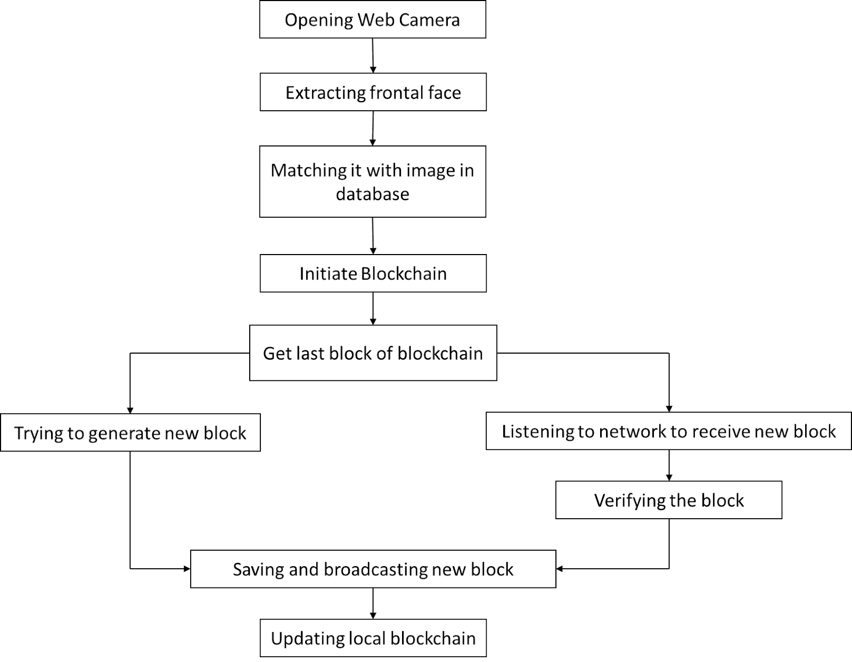

Slide 11
8. Suggestions given during review-1
In abstract, justify paragraph and check the title of report.
Optimize application and justify ML algorithm.
Need to justify the use of blockchain.

Slide 12
Thank You...!!

